Slide 1
Who is AP for?
Jenny Graham, Head of Research and Evaluation

Slide 2
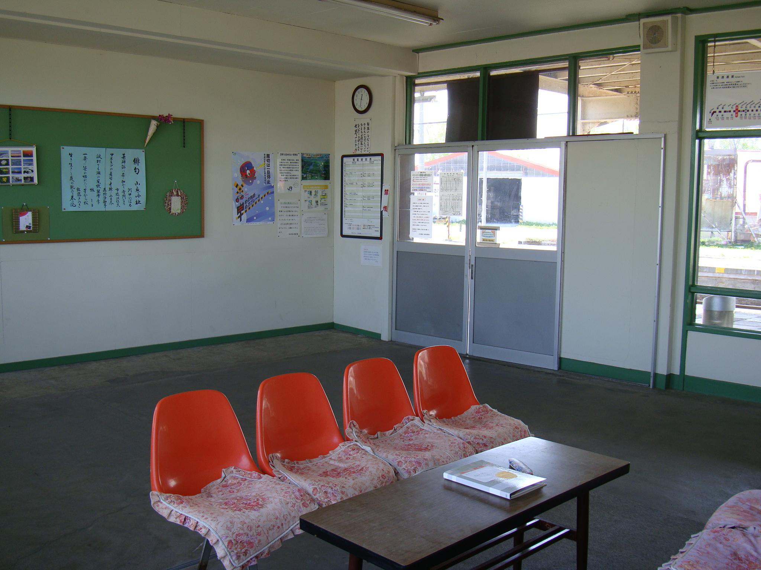
AP landscape - complex
32,083 pupils across at least 761 institutions (2021)
DfE counts ‘PRUs’ as 338 institutions that are either maintained PRUs or AP academy schools.
Nationally, 2.7 per 1,000 pupils are educated in AP. Regional variation - e.g. North East Lincolnshire was 7.7 per 1,000 pupils.
11,684 students last year in ‘PRU’ schools - counting only sole registered students.
“Who is AP for?” and similarly “What is AP for?” Dependent on the intersection of educational philosophy and your position in the educational landscape.
Perhaps more useful: “Who is in AP and why are those students there?”

Slide 3
Who is in AP and why are they there?
11,684 students in the ‘PRU section’ of AP
Unseen exclusion - part of a bigger picture of what doesn’t show up in official statistics. The level of unexplained exit across the education sector is an important and linked issue.
EPI’s (2019) work on Unexplained Exits: indicate a very high rate of exits from schools: as many as 1 in 10 pupils (10.1 per cent). This totals over 69,000 unexplained exits by over 61,000 pupils.
Nearly 40% of these students do not reappear on any school roll
3,928 who were formally Permanently Excluded (PEx)
= nearly 3 x more students in PRUs than were PExed
How do the other 7,756 students end up in AP?
Not in official exclusions data - ‘unseen exclusion’’
Alternatives to PEx - e.g. Managed moves
Can still come with social exclusion, potential stigma, impact on self esteem, loss of school-based peer network - so arguably a form of exclusion.

Slide 4
Who are the students in PRU/AP?
 | AP PRU schools | All pupil population
Free School Meals | 54.6% | 22.5%
SEN support | 54.0% | 12.6%
EHC plan | 28.2% | 4%
(Boys | 72.2% | 51%)
Students in AP are disproportionately those who are disadvantaged.

Slide 5
Outcomes in AP
 | AP/PRU schools | All pupil population
Grade 5 or above in English and Maths | 4.4% | 51%
Positive destination autumn term post KS4 | 54% | 94%
Conviction/caution by 19* | 41% (PEx 59%) | 5%
Entered for EBACC | 0.2% | 38.4%
* DfE/MoJ (2022) Education, children's social care and offending Descriptive Statistics. (Analysis of data on 1.63 million children ending KS4 in ‘12/’13, ‘13/’14 and ‘14/’15.

Slide 6
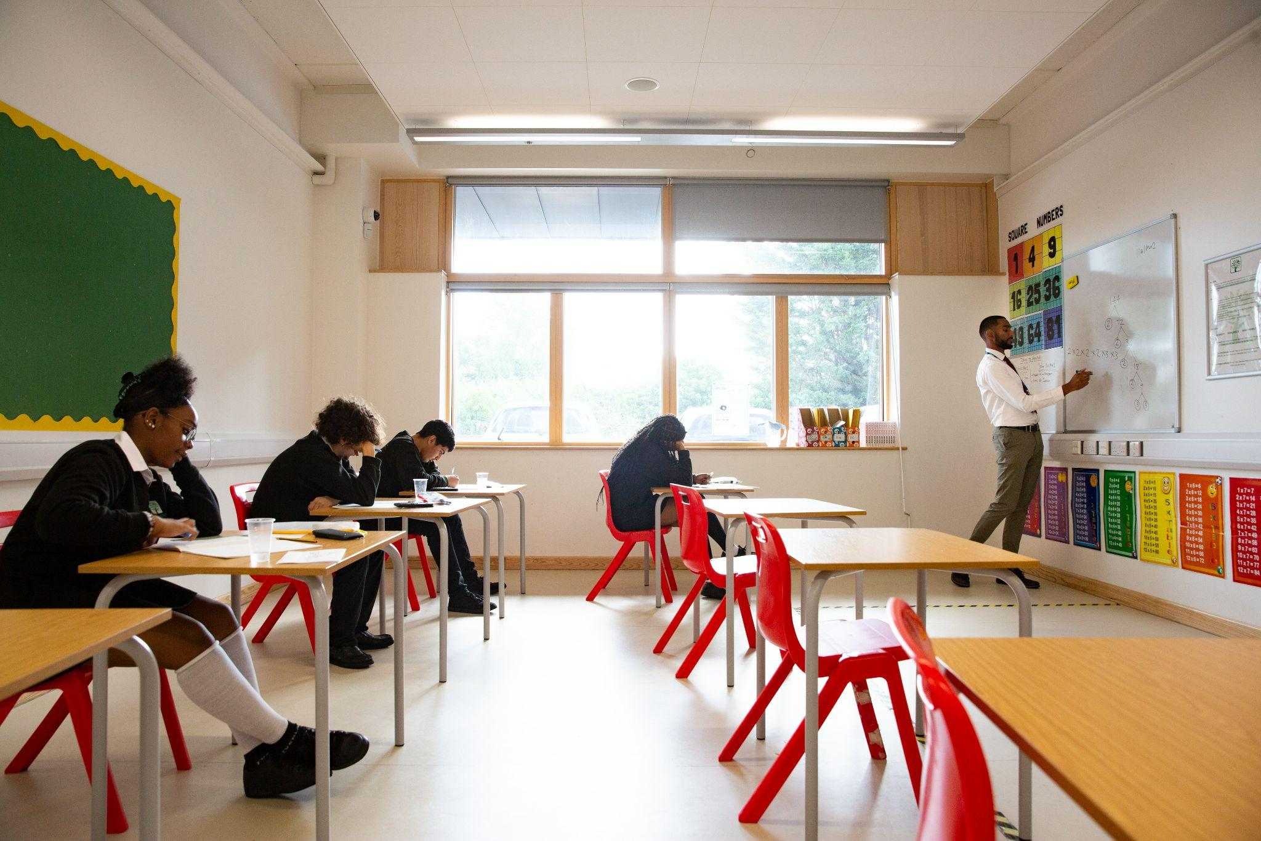
Who is AP for?
Those who:
Have been excluded
Are more likely to be male, have SEN, and be eligible for free school meals.
Are on an academic route divergent from higher performing peers.
AP can be there to reintegrate back into mainstream, yet currently the educational landscape, both in terms of policy and practice, doesn’t comprehensively facilitate this.
Three key questions emerge:
Is this what we want AP to do?
Is the number of students in AP at the right level?
If not, could different work in mainstream schools reduce the number of young people in AP from where it is now?

Slide 7
But what if….?
Regulatory and performance frameworks placed higher value on inclusion
Our school leaders were better placed to bring the same rigour that they do with teaching, learning and behaviour to inclusion
Our school practitioners developed their relational practices that benefit all, especially those for whom positive relationships can make the biggest difference
All school practitioners were trained and supported to understand and respond to the causes of the challenging behaviour they may experience
Our schools had the resources to draw on, in and out of school to properly support students, early on, with the things that might make it harder to access learning
…….Then - who would AP be for?

